Slide 1
Telecom Churn CASE STUDY
By ANURAG AGARWAL ONLY

Slide 2
Business Problem Overview
In the telecom industry, customers are able to choose from multiple service providers and actively switch from one operator to another.
telecommunications industry experiences an average of 15-25% annual churn rate. Given the fact that it costs 5-10 times more to acquire a new customer than to retain an existing one, customer retention has now become even more important than customer acquisition.
For many incumbent operators, retaining high profitable customers is the number one business goal. To reduce customer churn, telecom companies need to predict which customers are at high risk of churn.
In this project , will analyze customer-level data of a leading telecom firm, build predictive models to identify customers at high risk of churn and identify the main indicators of churn.

Slide 3
Business Objective
to predict the churn in the last (i.e. the ninth) month using the data (features) from the first three months. To do this task well, understanding the typical customer behavior during churn will be helpful.
This business problem is focused on reducing customer churn in the telecom industry.
Churn is defined as the act of a customer leaving a particular service provider and switching to a competitor.
The project will focus on high-value customers, who are defined based on a certain metric and are responsible for 80% of the revenue in the Indian and Southeast Asian markets.
The goal is to reduce the churn of high-value customers and thereby reduce significant revenue leakage.

Slide 4
Data Analysis & Preparation Steps
Data Dictionary and Data reading & Understanding
Data Preparation
Filter high-value customers using the 70th percentile of the average recharge amount in the first two months.
Tag churners based on the usage of calls and mobile internet in the fourth month and remove all the attributes corresponding to the fourth month.
- Build predictive models to predict churn and identify important predictor attributes.
- Handle class imbalance by using techniques such as oversampling or under sampling.
- Visualize the important predictors and recommend strategies to manage customer churn based on the observations.
EDA
Data Cleaning, Treating Missing values
Model Building on Test and Train data
Model Evaluation on Test and Train data
Recommendation's

Slide 5
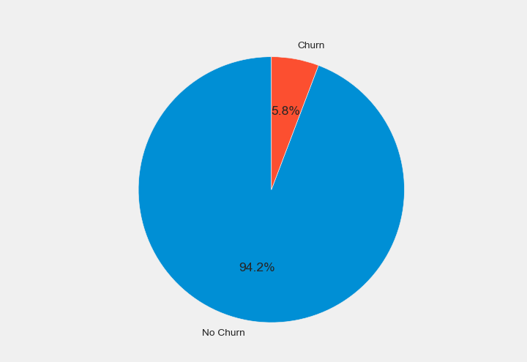
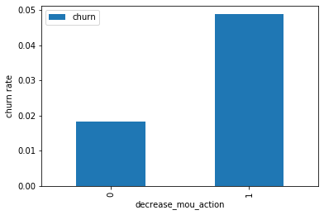
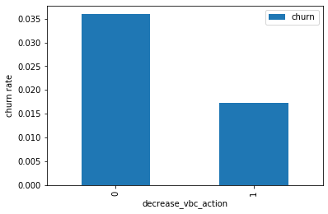
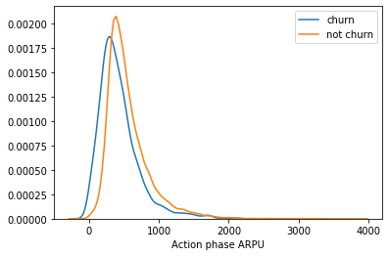
EDA & Findings
Data is Highly Imbalanced only 5.8% of data for churn customer
Higher churn for the customers, whose amount of recharge in the action phase is lesser than the amount in good phase.
Higher churn for the customers, That means the customers do not do the monthly recharge more when they are in the action phase.
Average revenue per user (ARPU) for the churned customers is mostly densed on the 0 to 900. The higher ARPU customers are less likely to be churned.

Slide 6
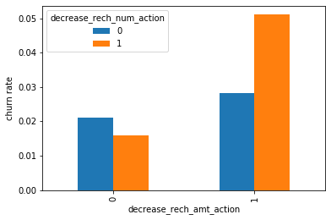
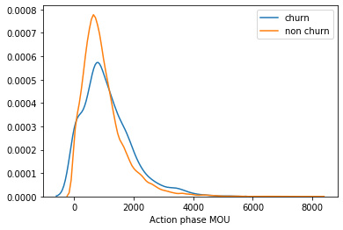
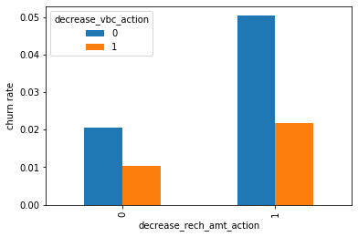
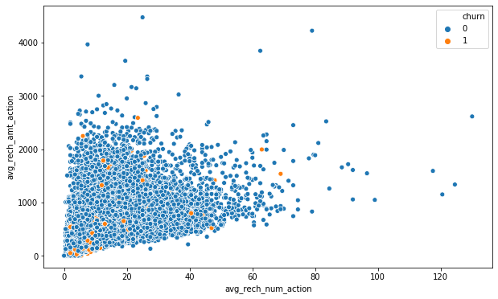
EDA & Findings
Minutes of usage(MOU) of the churn customers is mostly populated on the 0 to 2500 range. Higher the MOU, lesser the churn probability.
Higher churn customers, whose recharge amount as well as number of recharge have decreased in the action phase than the good phase.
churn rate is more for the customers, whose recharge amount is decreased along with the volume based cost is increased in the action month.
recharge number and the recharge amount are mostly propotional. More the number of recharge, more the amount of the recharge.

Slide 7
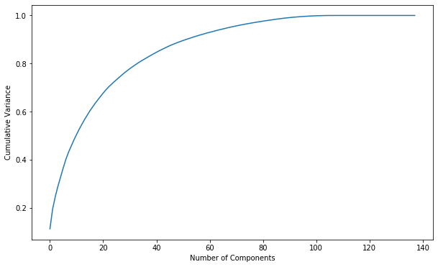
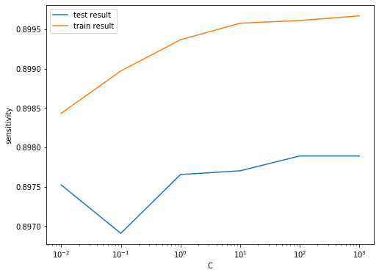
With PCA method we observed `60 components` explain almost more than 90% variance of the data. So, we will perform PCA with 60 components.
While with LR with PCA we didn’t get the good results on Train and Test data

Slide 8
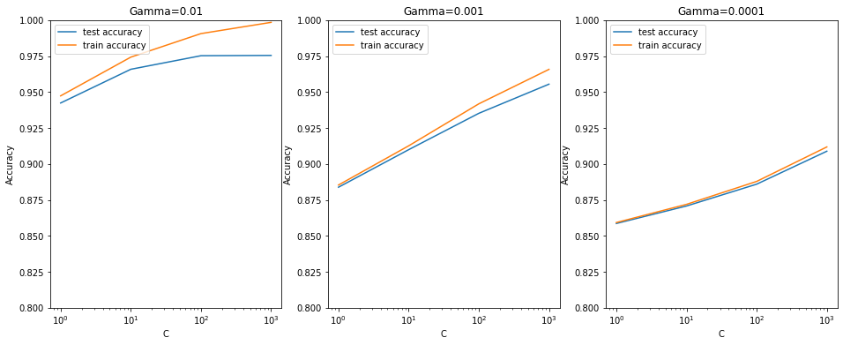
We can achieve comparable average test accuracy (~90%) with gamma=0.0001 as well, though we'll have to increase the cost C for that. So to achieve high accuracy, there's a tradeoff between:
High gamma (i.e. high non-linearity) and average value of C & Low gamma (i.e. less non-linearity) and high value of C
We argue that the model will be simpler if it has as less non-linearity as possible, so we choose gamma=0.0001 and a high C=100.

Slide 9
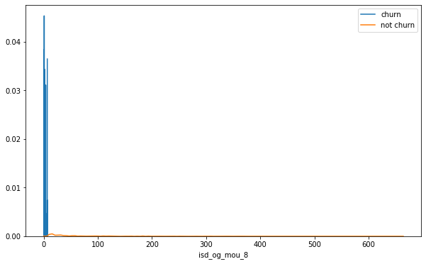
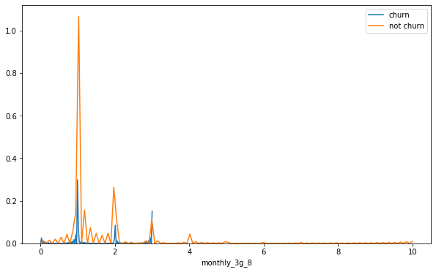
Final Model Visualization
We can see that the ISD outgoing minutes of usage for the month of August for churn customers is dense approximately to zero. On the on there hand for the non churn customers it is little more than the churn customers.
The number of monthly 3g data for August for the churn customers are very much populated around 1, whereas of non churn customers it speeded across various numbers.

Slide 10
Final Model
| Variables | Coefficients |
|loc_ic_mou_8|-3.3287|
|og_others_7|-2.4711|
|ic_others_8|-1.5131|
|isd_og_mou_8|-1.3811|
|decrease_vbc_action|-1.3293|
|monthly_3g_8|-1.0943|
|std_ic_t2f_mou_8|-0.9503|
|monthly_2g_8|-0.9279|
|loc_ic_t2f_mou_8|-0.7102|
|roam_og_mou_8|0.7135|

Slide 11
RECOMMENDATIONS
We can see most of the top variables have negative coefficients. That means, the variables are inversely correlated with the churn probability.
1. Target the customers, whose minutes of usage of the incoming local calls and outgoing ISD calls are less in the action phase (mostly in the month of August).
2. Target the customers, whose outgoing others charge in July and incoming others on August are less.
3. Also, the customers having value based cost in the action phase increased are more likely to churn than the other customers. Hence, these customers may be a good target to provide offer.
4. Customers, whose monthly 3G recharge in August is more, are likely to be churned.
5. Customers having decreasing STD incoming minutes of usage for operators T to fixed lines of T for the month of August are more likely to churn.
6. Customers decreasing monthly 2g usage for August are most probable to churn.
7. Customers having decreasing incoming minutes of usage for operators T to fixed lines of T for August are more likely to churn.
8. roam_og_mou_8 variables have positive coefficients (0.7135). That means for the customers, whose roaming outgoing minutes of usage is increasing are more likely to churn.

